Slide 1
Retail Sales Performance Analysis Using SQL, Power BI, Tableau, and Excel
Presented by Shaik Arshiya Fathima

Slide 2
Data Cleaning in SQL
Firstly i have imported the data into the schema and I have done some data cleaning process by using some queries. Such as:
Remove Rows with NULL or Empty Critical Fields
Normalize Country and Description Text (Uppercase, Trim)
Remove Rows with Negative or Zero Quantity
Add Unique Identifier (if missing) — For Row-Level Ops
Remove Duplicate Rows
Standardize Time Format (if stored as string)
Trim and Clean Stock Code (Remove junk characters)
Filter Out Test or Dummy Data
Clean Record Count

Slide 3
EDA in SQL
EDA is the process of:
Summarizing the dataset (e.g., distributions, data types)
Visualizing patterns (e.g., trends, correlations)
Identifying missing values, duplicates, or outliers
Preparing the data for modeling or reporting
In this i have taken only one table i.e, onlineretailnine(2009-2010). These are the queries i have done in that:
Understand Table Structure
Count Rows
Count NULLs per column
Unique values in categorical columns
Check for Duplicates
Quantity Distribution
Top Countries by Transactions
Most Common Products
Daily Transaction Trend

Slide 4
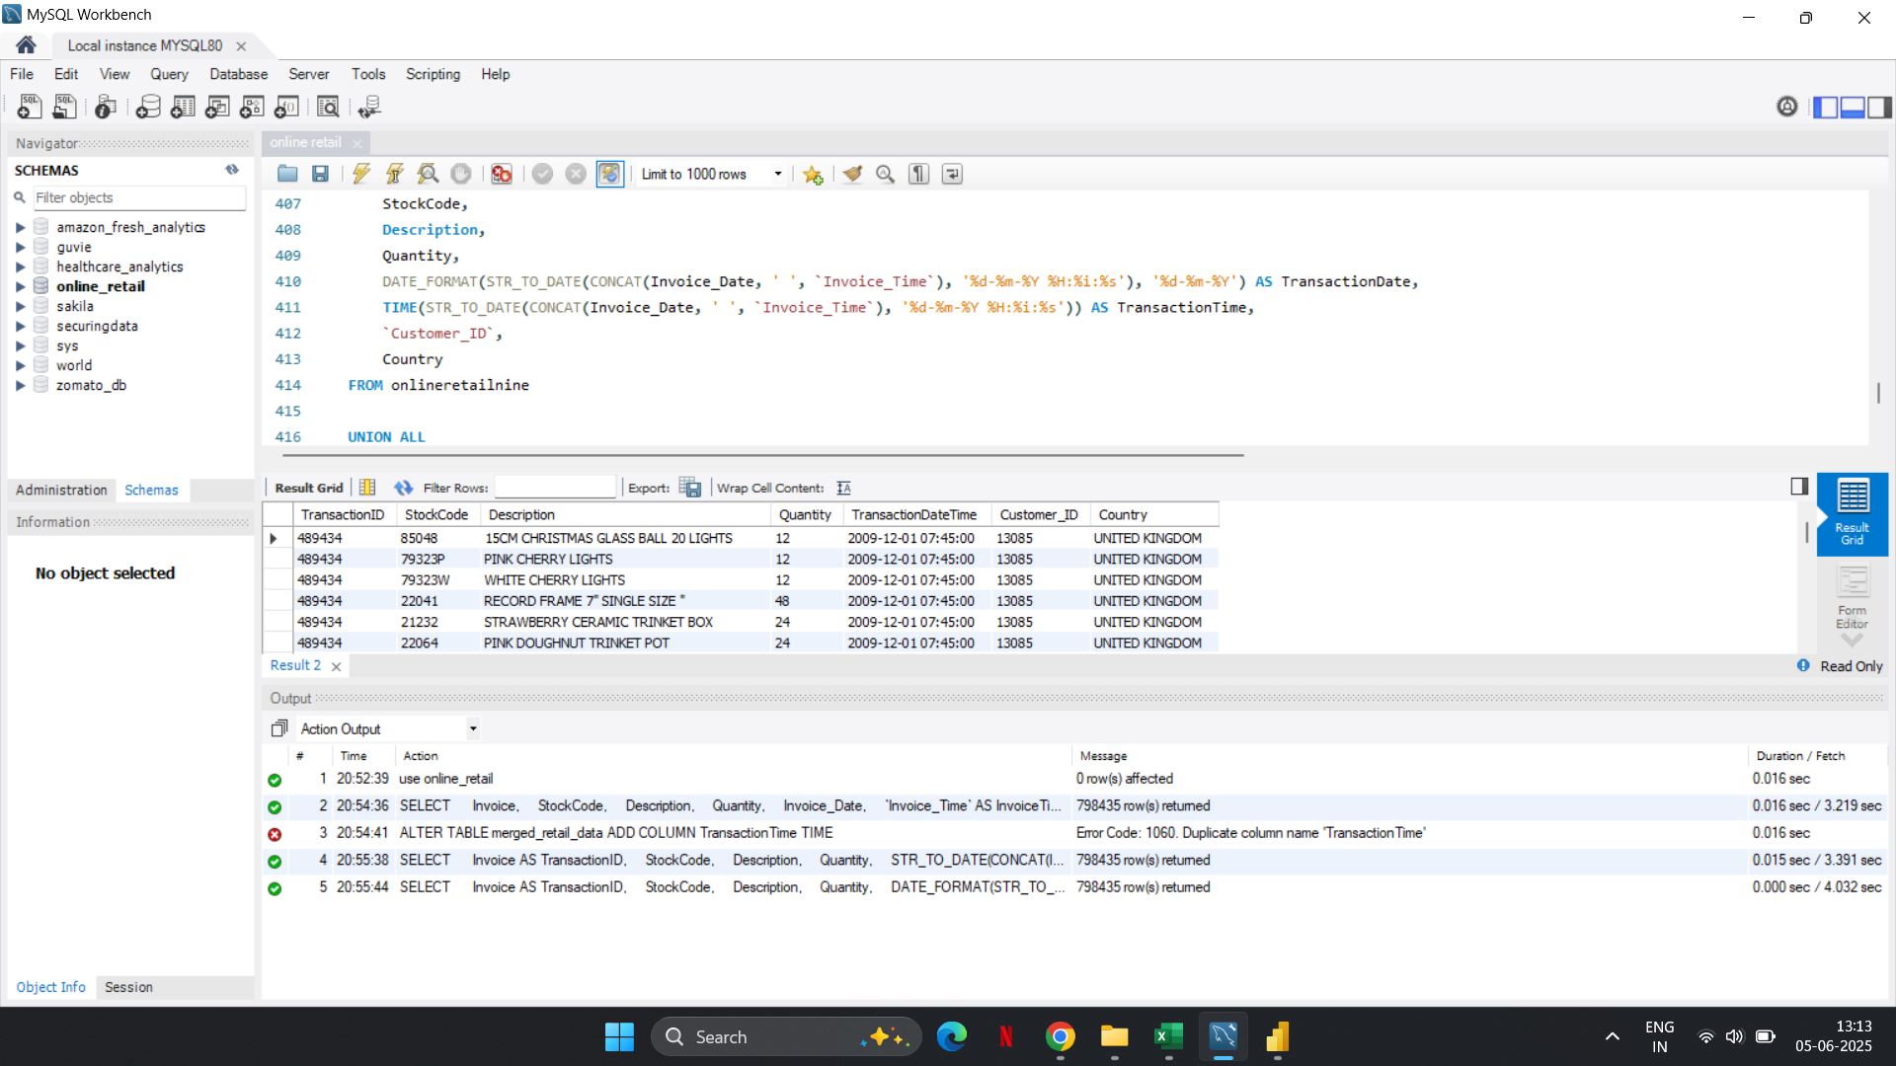
I have merged those three tables in one table by the help of SQL queries called “Online Retail”

Slide 5
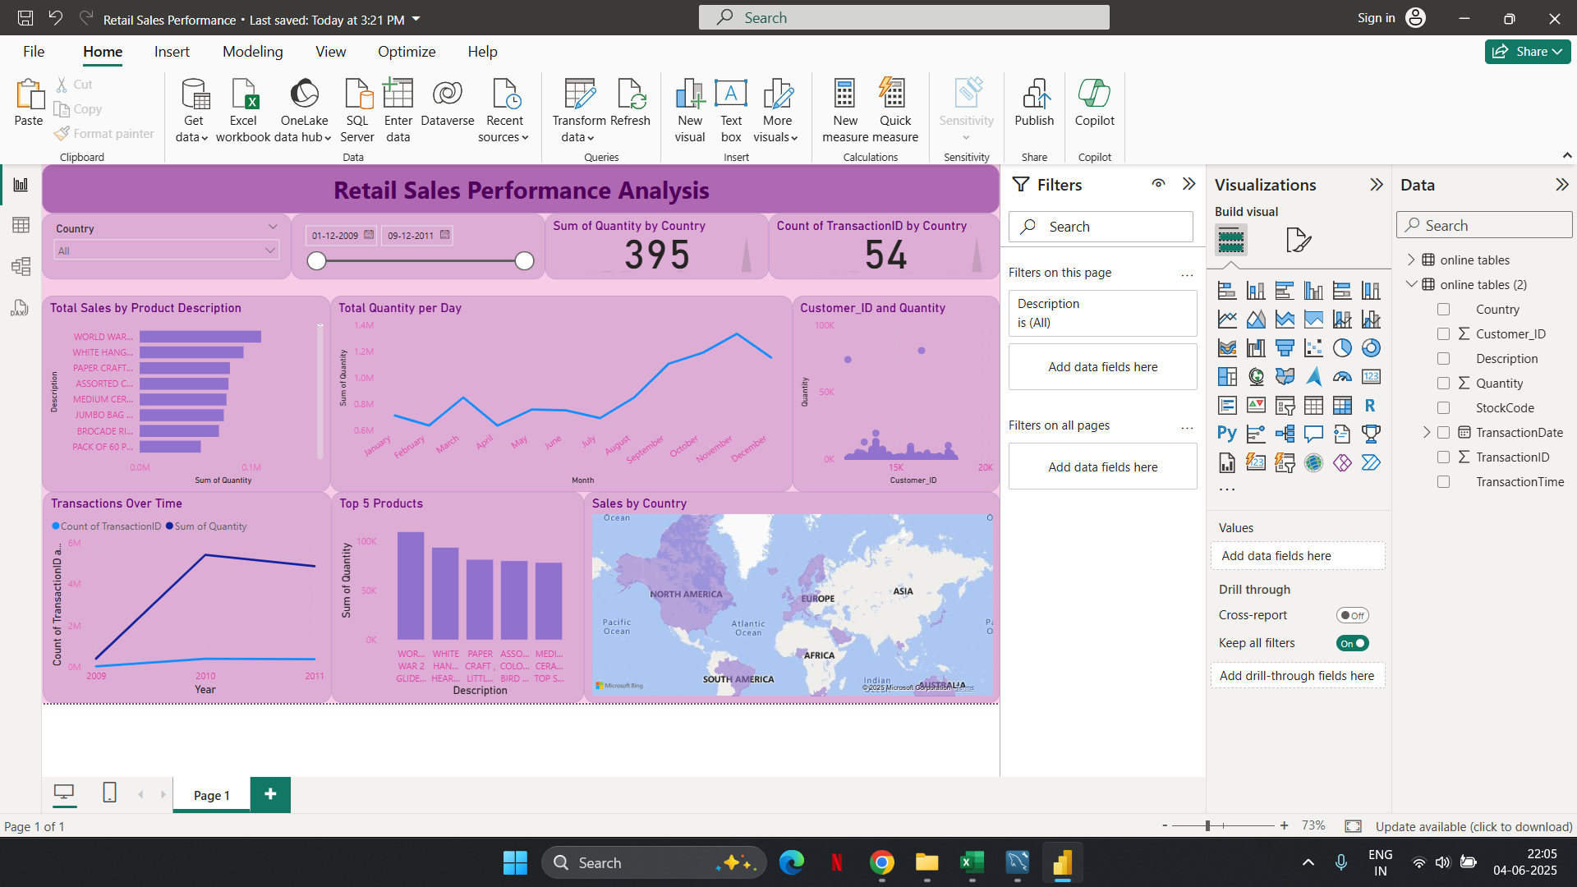
DashBoard
This is the dashboard i have created based on the given data.

Slide 6
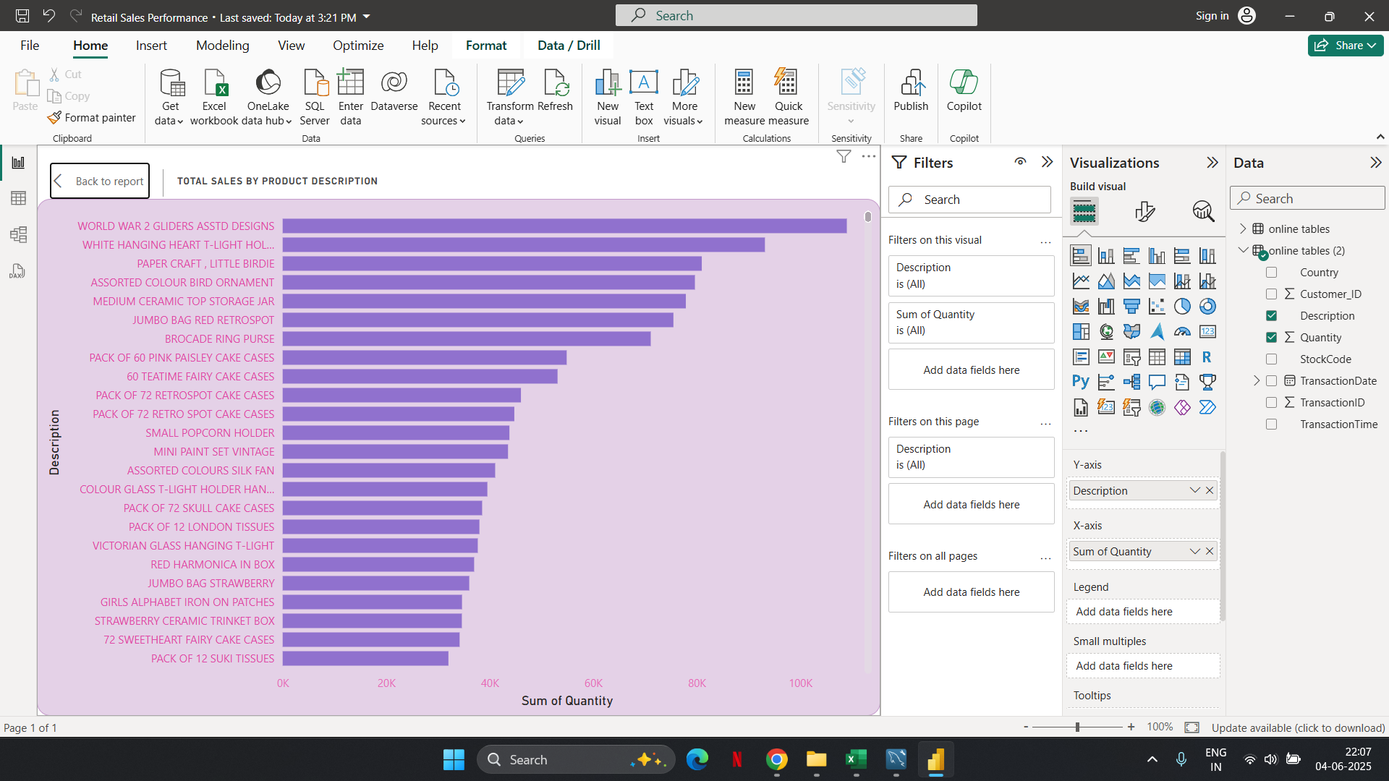
Chart Description
This is the chart of Total Sales by Product Description.

Slide 7
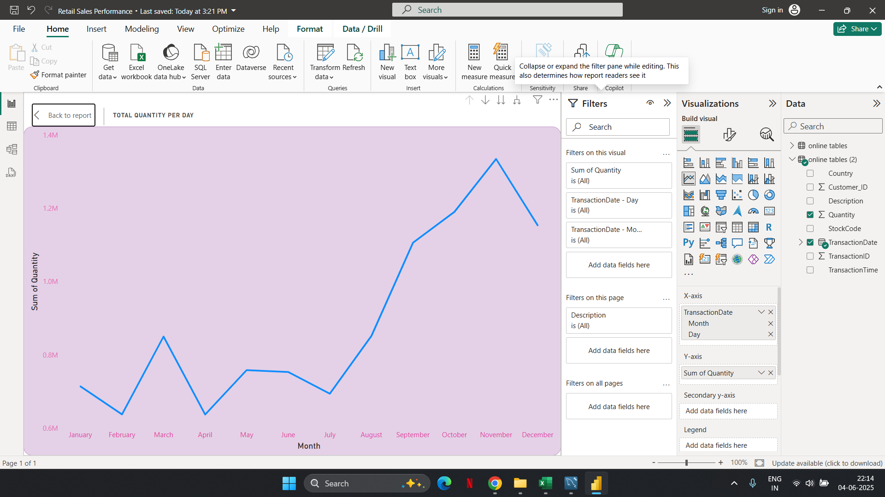
Chart Description
This is the chart of Total Quantity per Day.

Slide 8
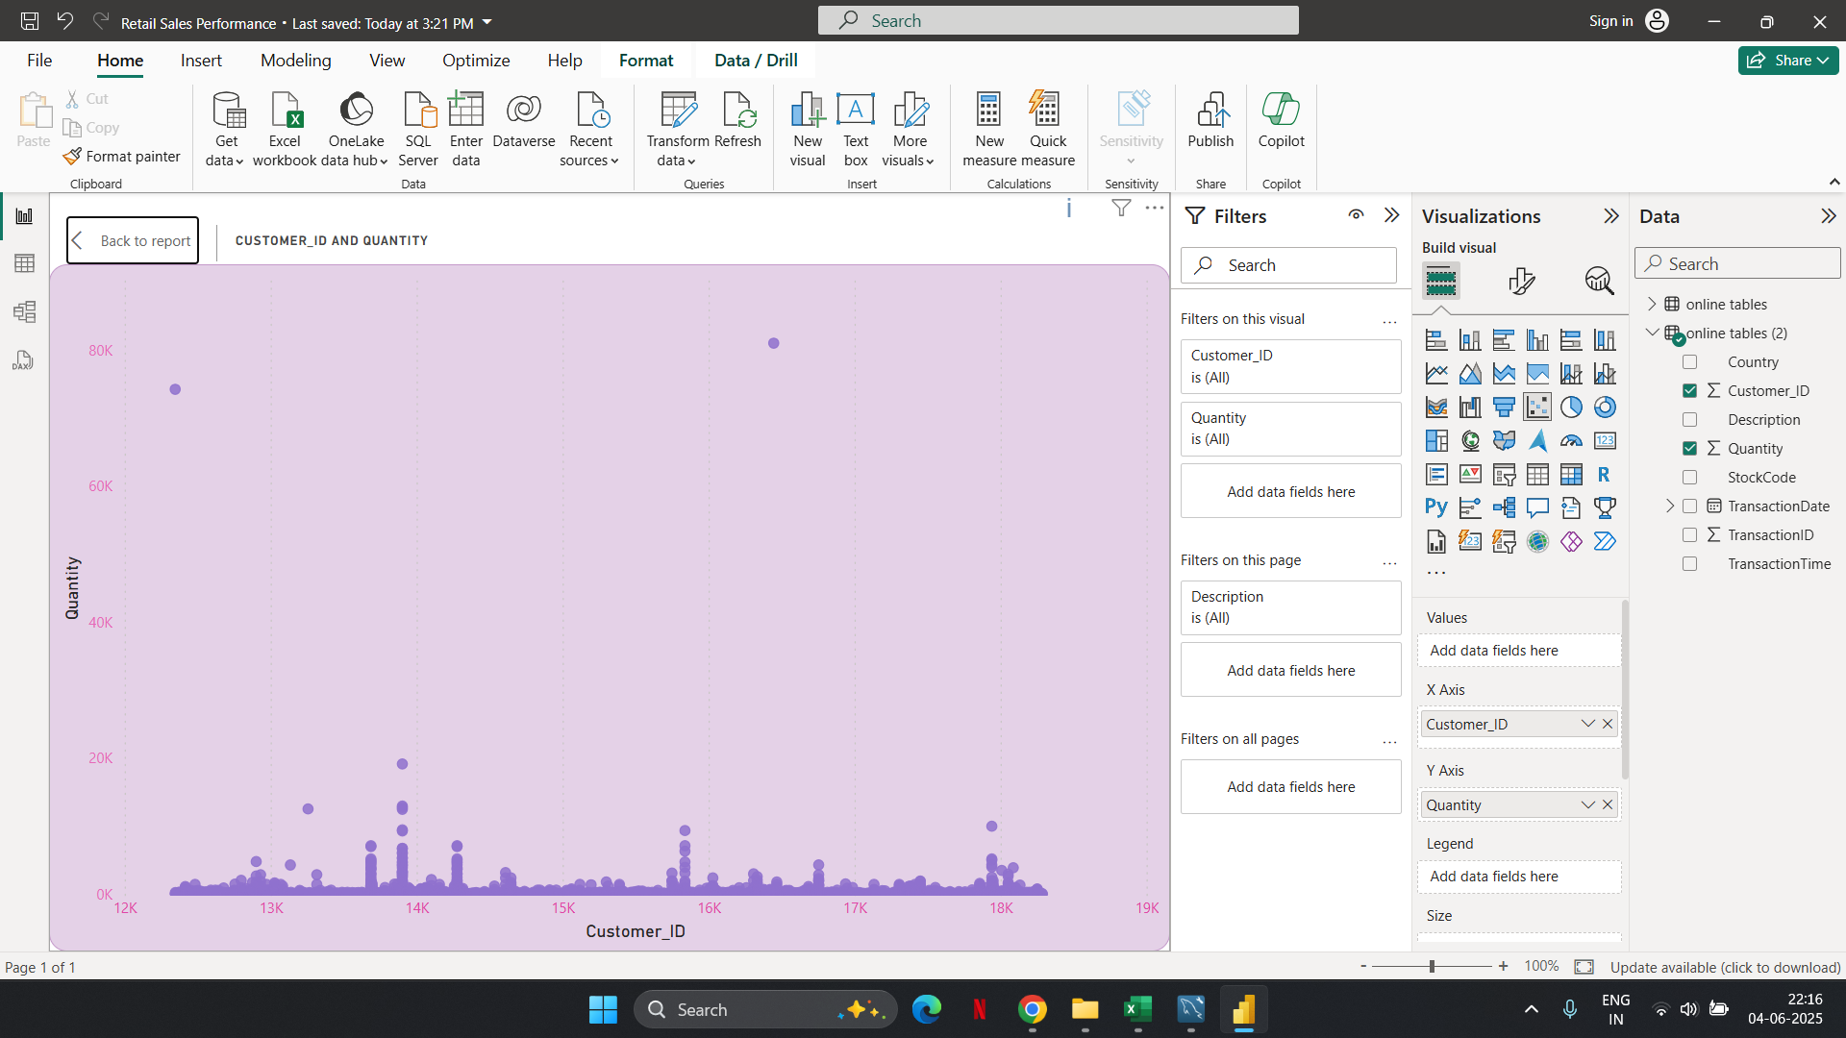
Chart Description
This is the chart of Customer Purchase Pattern

Slide 9
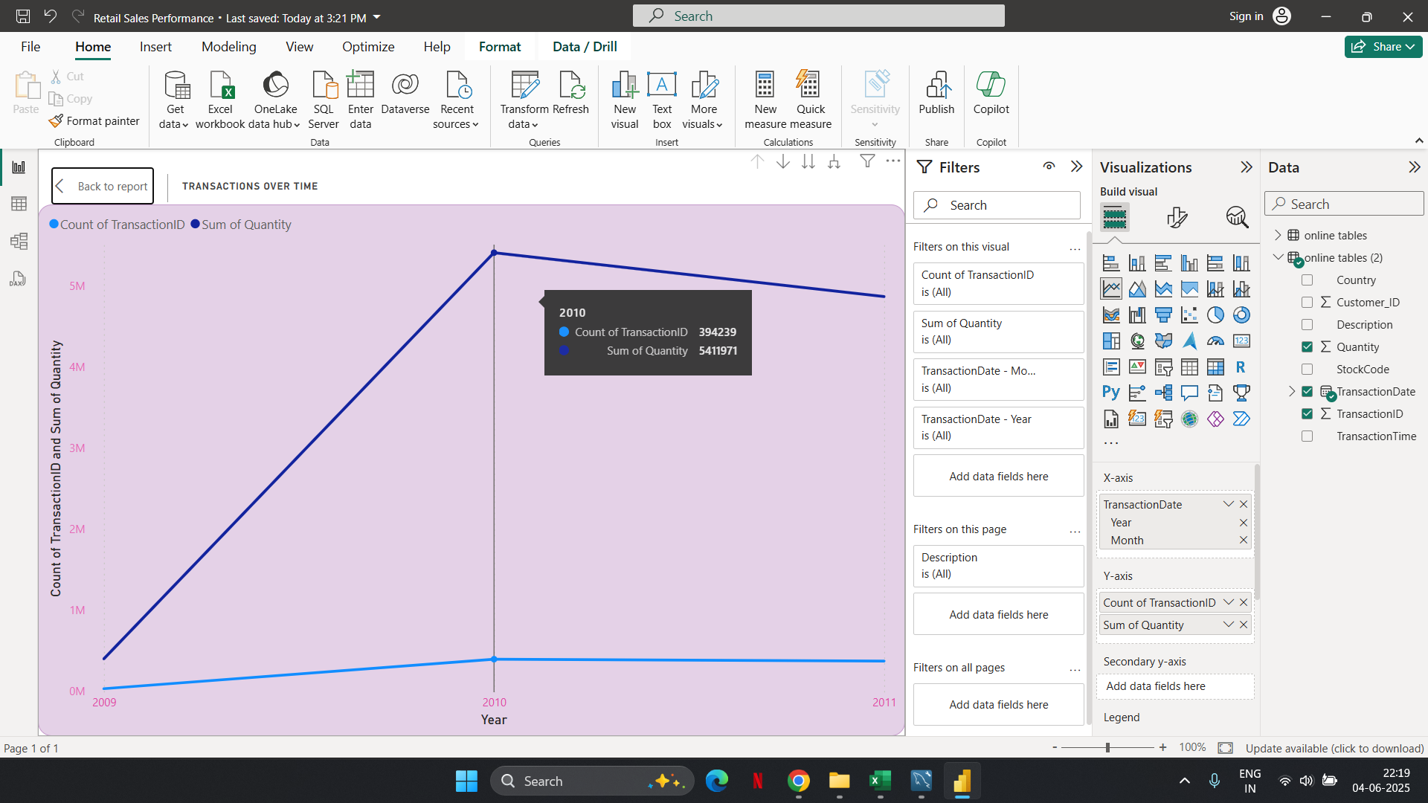
Chart Description
This is the chart of Transaction Over Time.

Slide 10
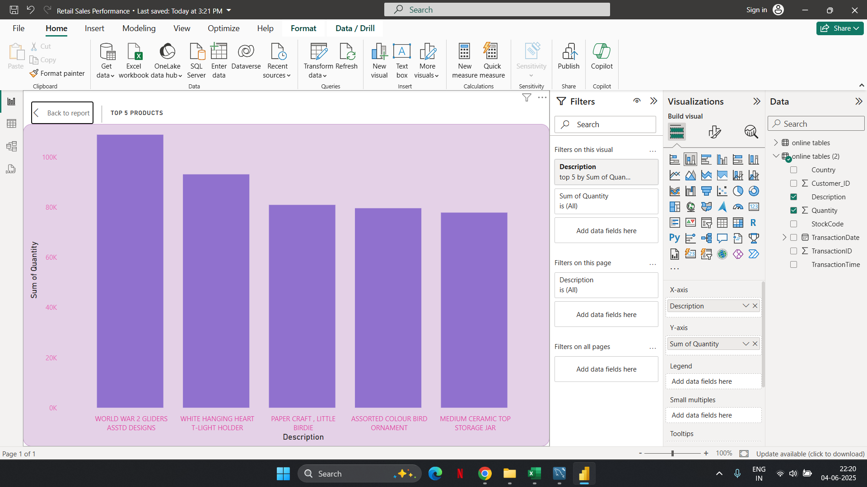
Chart Description
This is the chart of Top 5 Products.

Slide 11
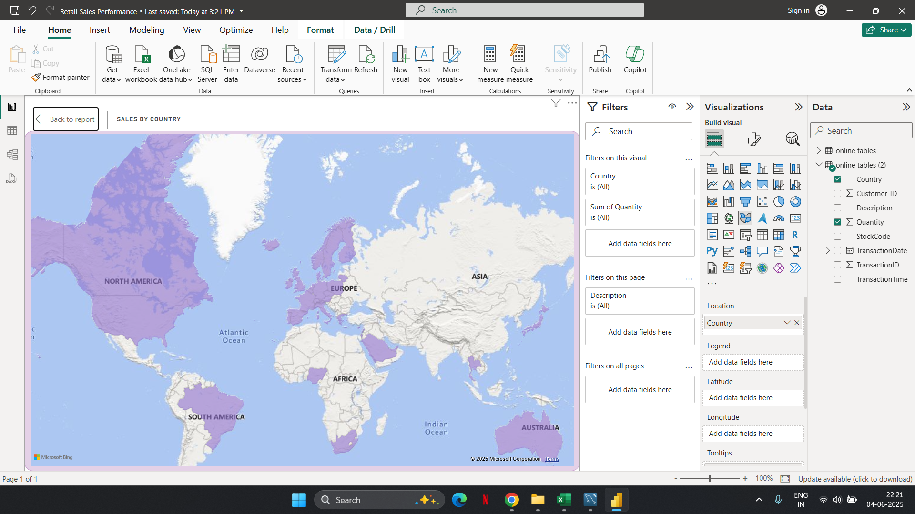
Chart Description
This is the chart of Sales By Country.

Slide 12
Retail Sales Performance Dashboard Summary
📦 Top Products Identified: "WORLD WAR 2 GLIDER" and "WHITE HANGING HEART" are among the highest-selling items by quantity.
🌍 Sales Distribution by Country: Major contributions from European and North American regions, as visualized on the world map.
📈 Monthly Sales Trend: Quantity sold shows a consistent upward trend, with peak sales observed in November and December.
⏳ Year-over-Year Growth: Transactions and sales quantities significantly increased from 2009 to 2011, indicating strong business growth.
👥 Customer Insights: The dashboard tracks customer purchase patterns and highlights total unique transactions and quantity per country.

Slide 13
Recommendations Based on Dashboard Analysis
💡 Focus Marketing on Best-Selling Products Promote top products like "WORLD WAR 2 GLIDER" and "WHITE HANGING HEART" through featured ads, discounts, and bundles to maximize revenue.
🌐 Expand to High-Potential Markets Since Europe and North America show strong sales, consider deeper market penetration or targeted campaigns in underperforming but high-potential regions like Asia or South America.
📅 Capitalize on Peak Sales Months Intensify promotional campaigns during November and December, when sales quantities spike, using seasonal themes, email marketing, and flash sales.
📊 Monitor Yearly Growth Patterns Keep tracking transaction trends year-over-year. Consider forecasting future sales based on historical data to optimize stock and operations.
👥 Enhance Customer Retention Strategies Use customer transaction data to build loyalty programs, personalized offers, or re-targeting campaigns based on purchase behavior.

